Slide 1
Denoise Microscopic Data With Deep Learning
Group no.2
Syeda Qurat ul Ain Naqvi
Sonali Godavarthy
Zakriya Shakeel

Slide 2
Non-DL Approach Results
We added Gaussian Noise to a image and denoised it using
Box Filter
Gaussian Filter
Median Filter
Box3D Filter
Weiner Filter

Slide 3
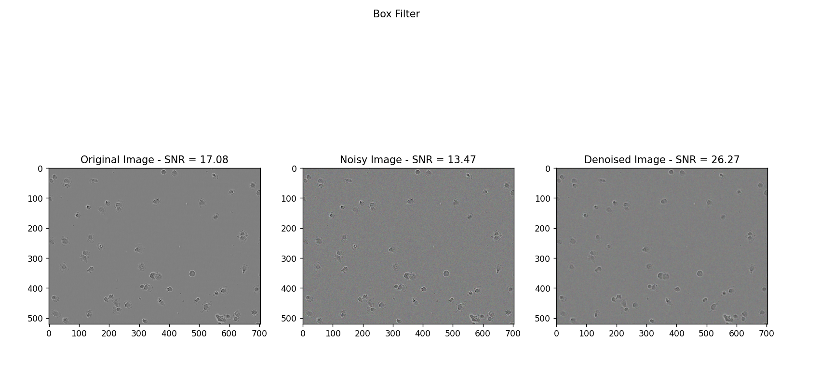

Slide 4
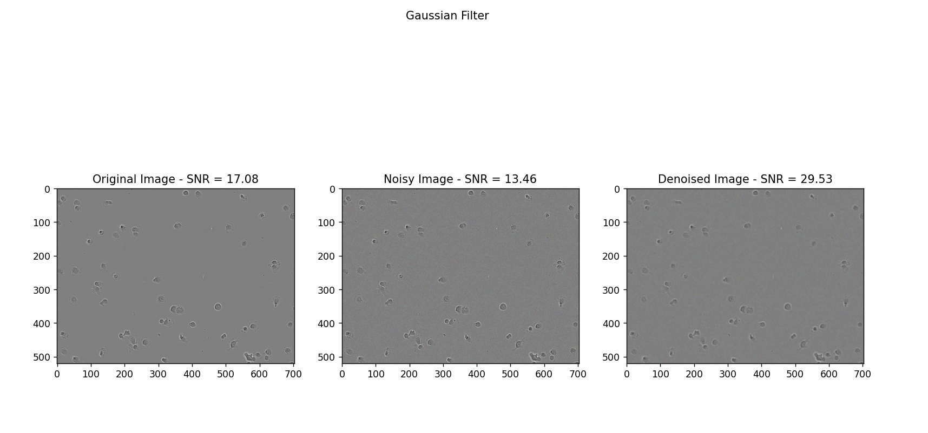

Slide 5
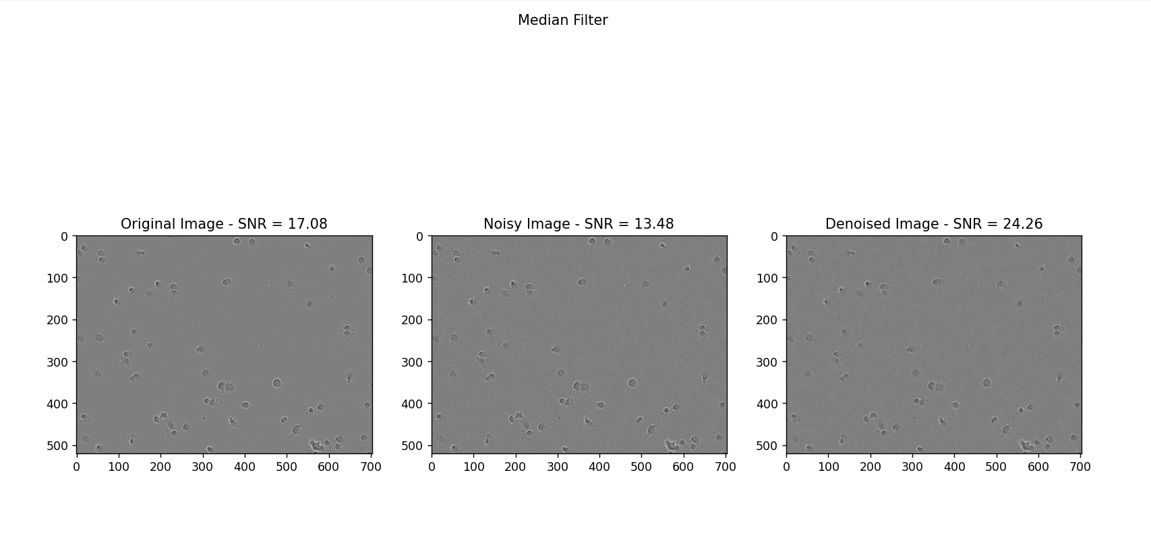

Slide 6
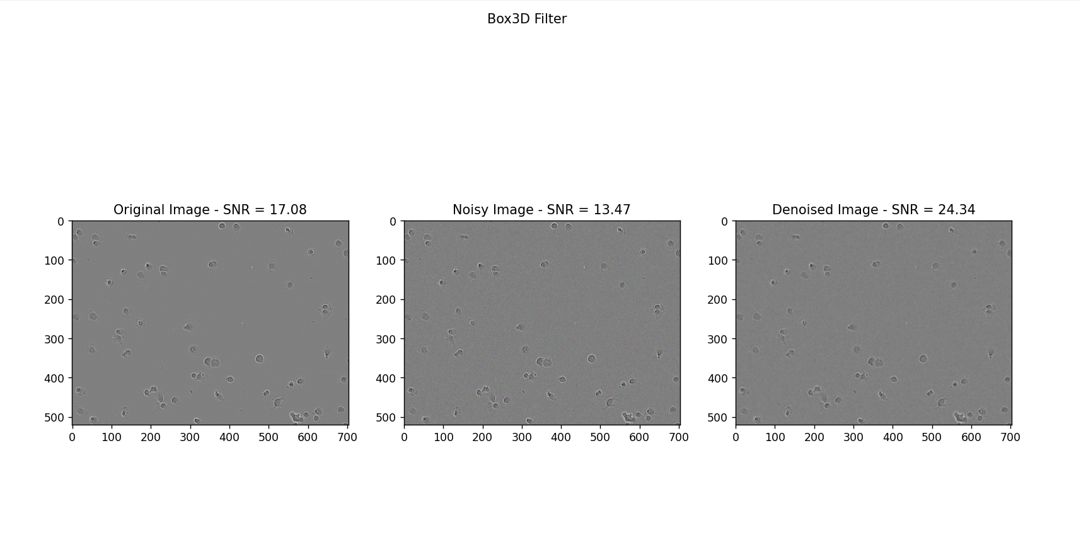

Slide 7
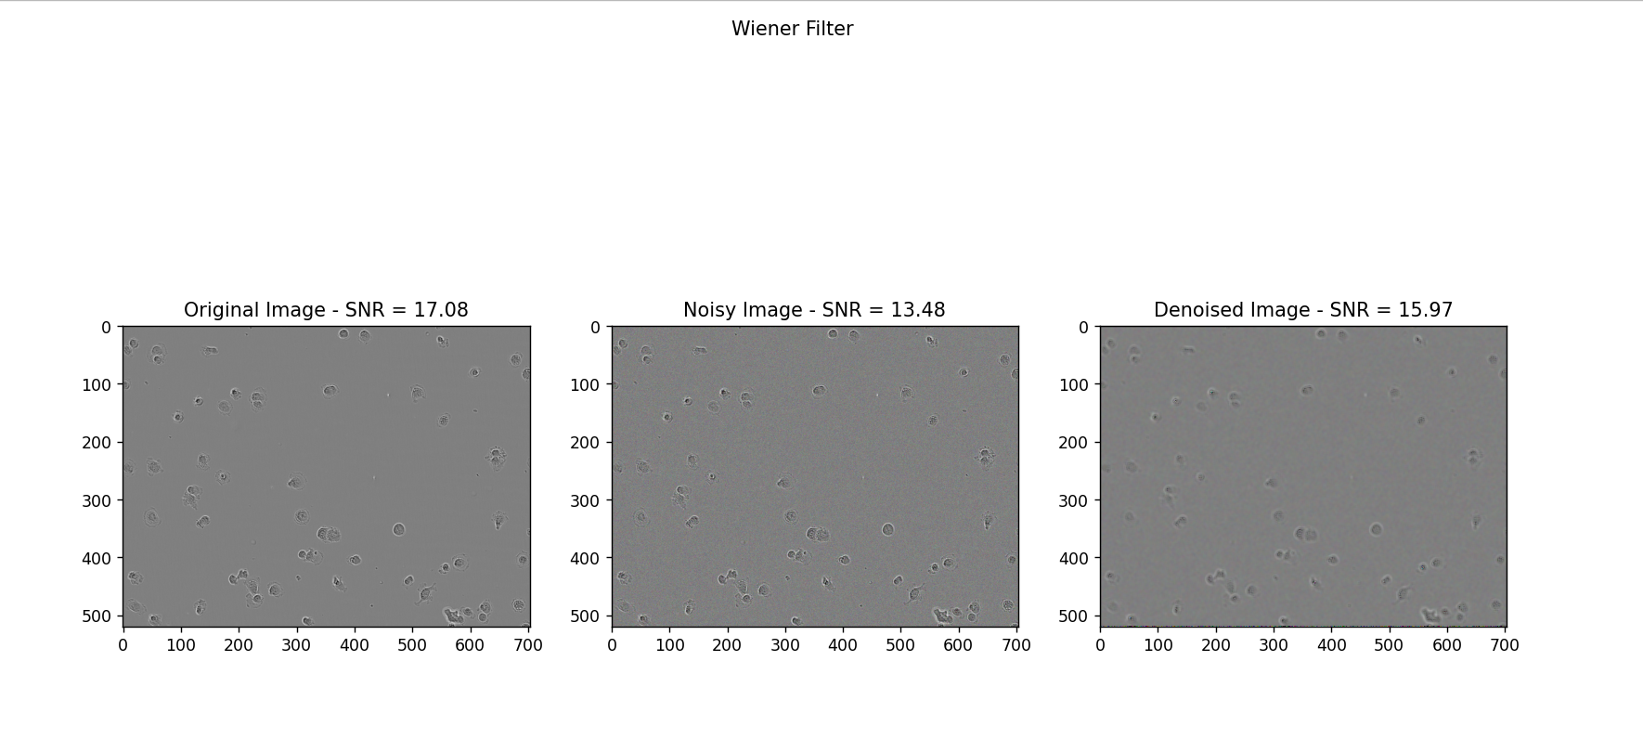

Slide 8
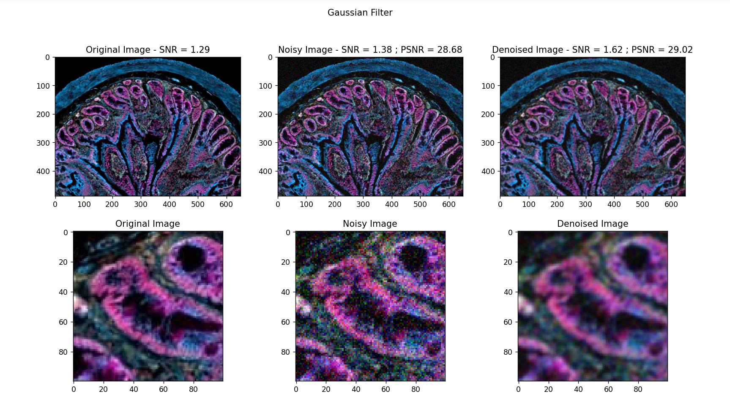

Slide 9
DL Approach Results
We have trained the model with Point Spread Function(sigma)= 0.5, 1.0 and 1.5 using the dataset provided by the writers of the research paper
We have denoised the images using the same model
We applied the model to our own dataset

Slide 10
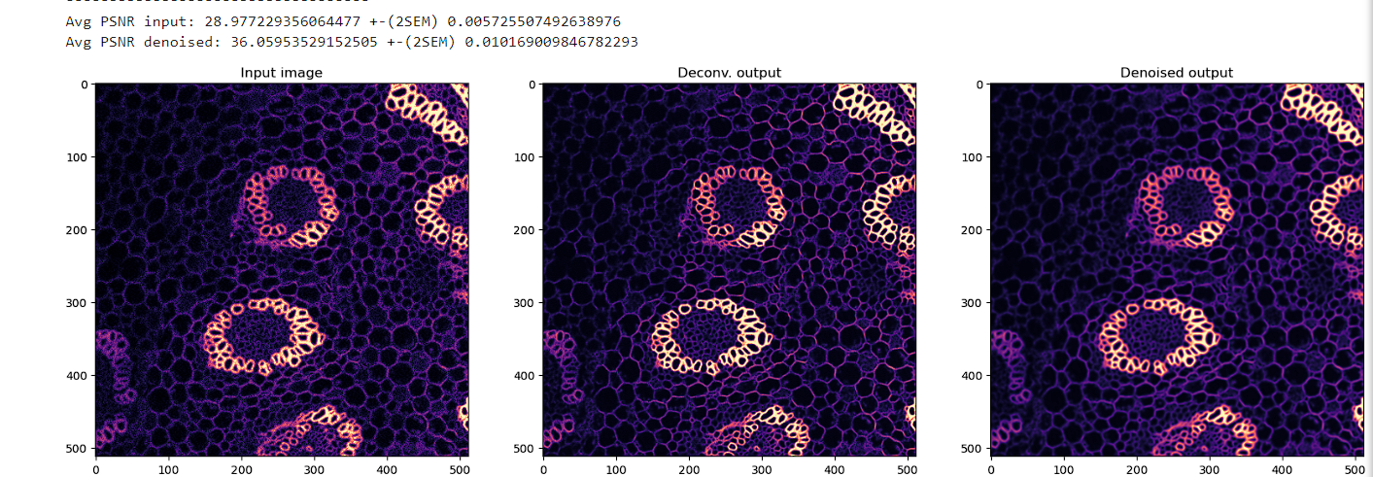
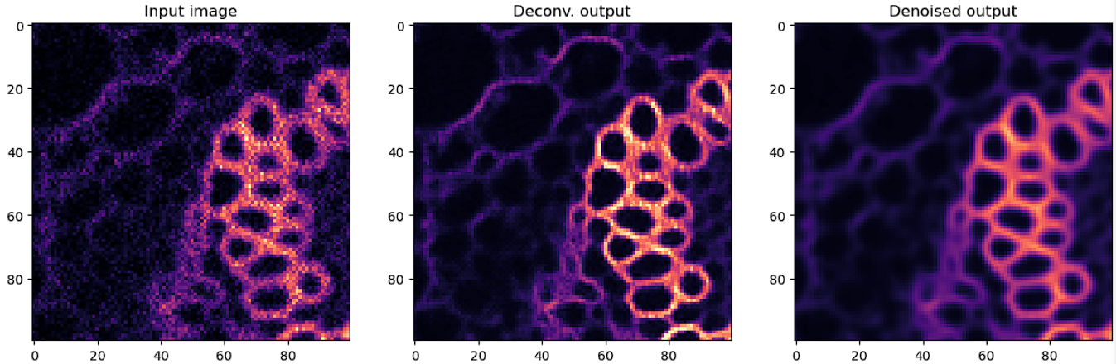
Results of their own Noisy Microscopic Image

Slide 11
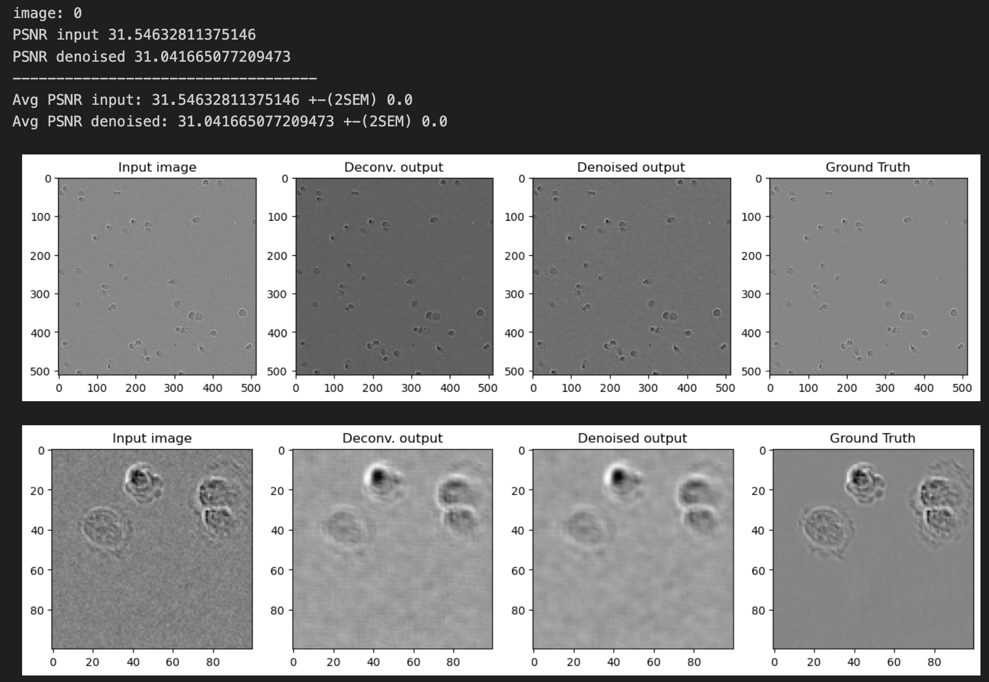
Results of our Noisy Microscopic Image with PSF=0.5

Slide 12
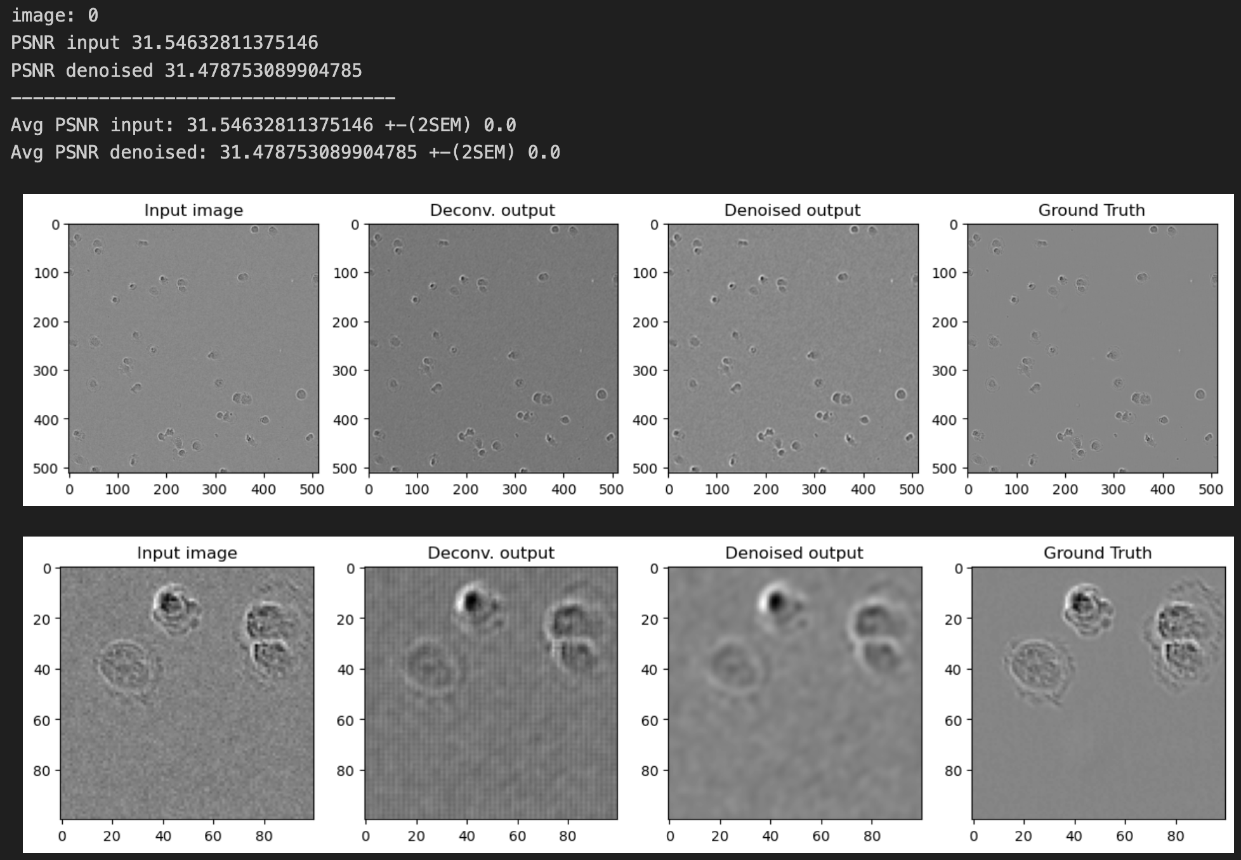
Results of our Noisy Microscopic Image with PSF=1.0

Slide 13
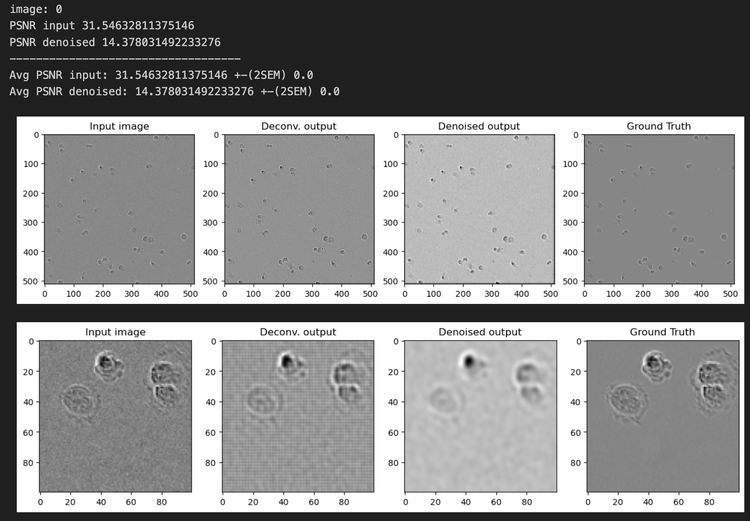
Results of our Noisy Microscopic Image with PSF=1.5

Slide 14
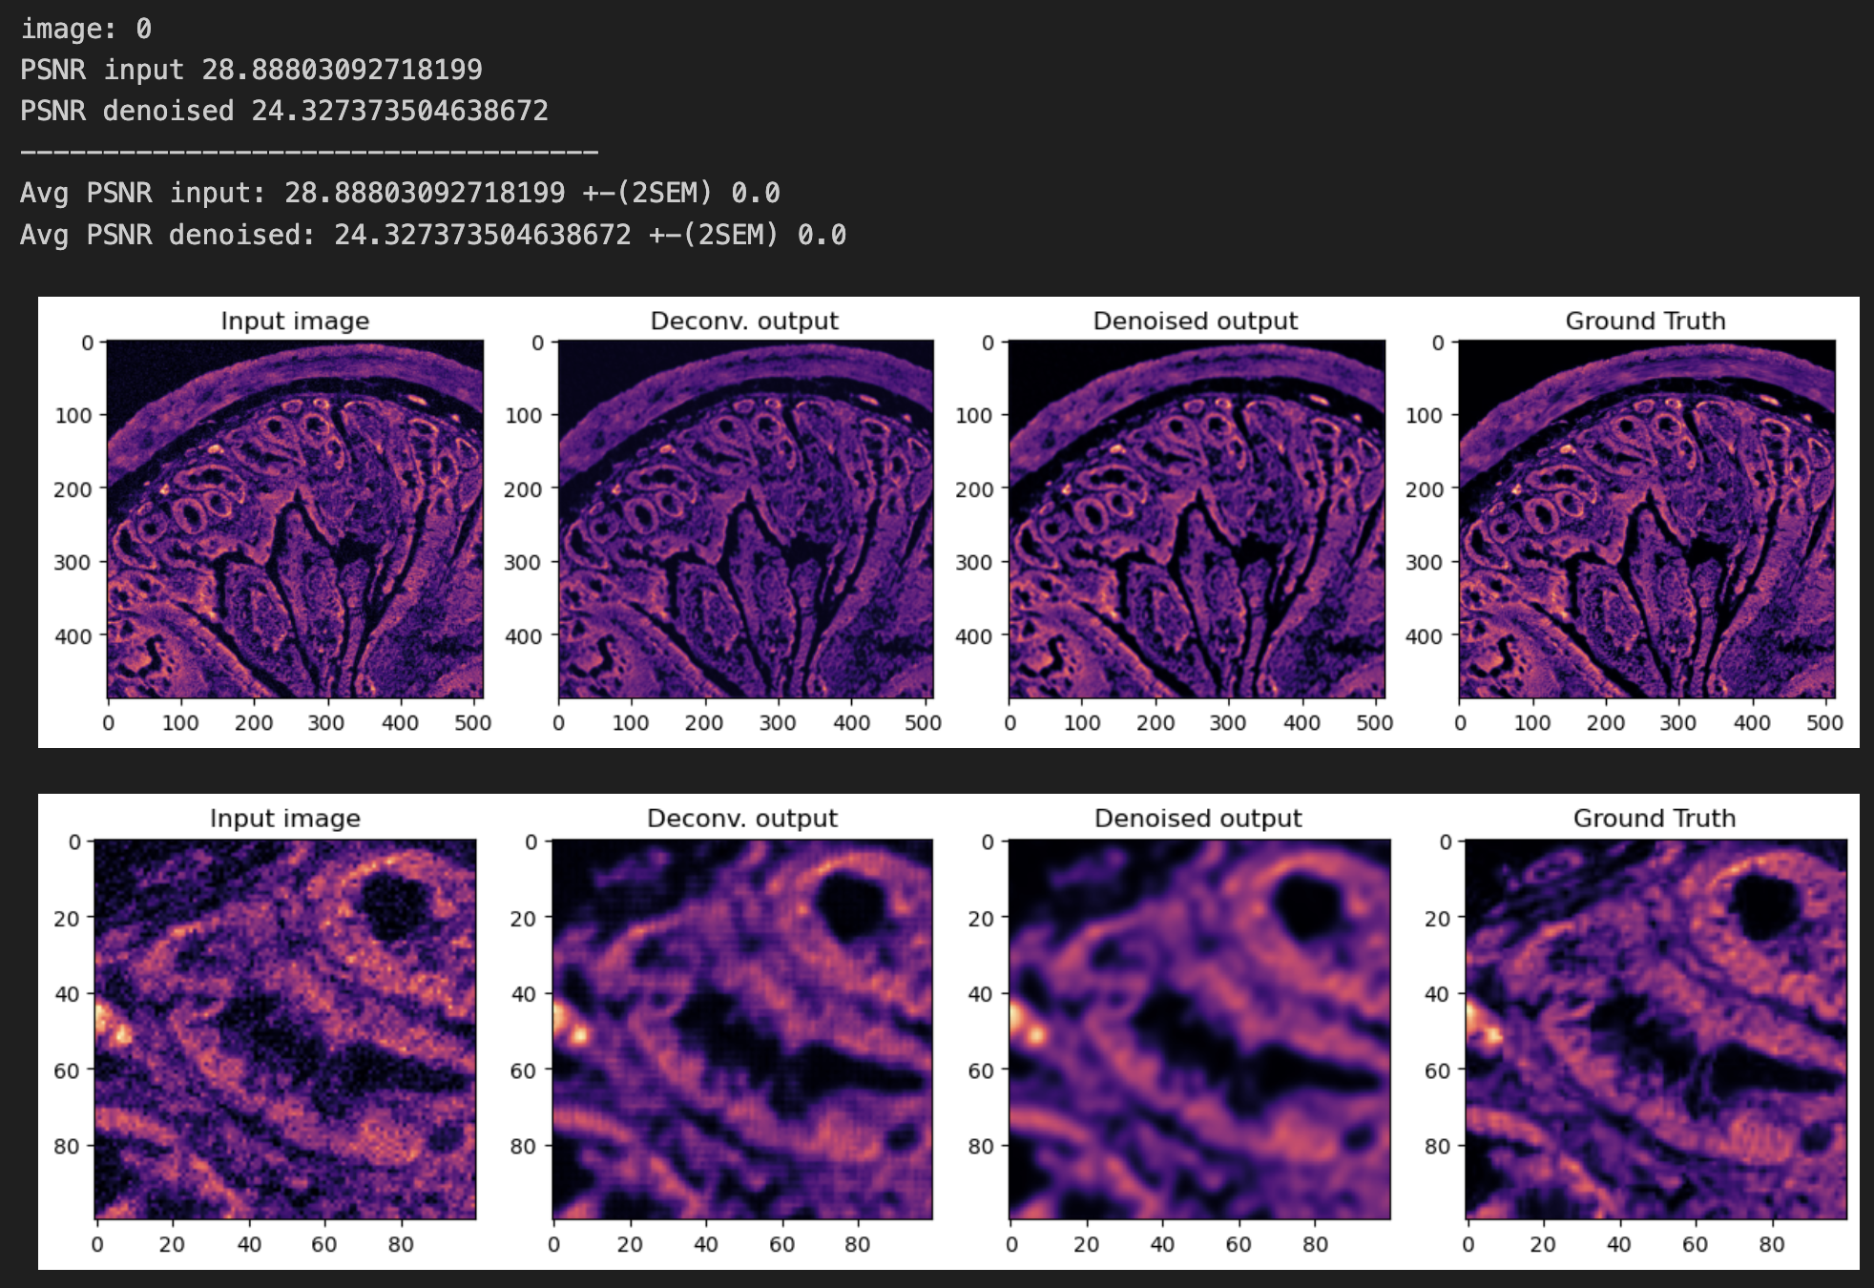
Results of other Fluorescent Noisy Microscopic Image with PSF=0.5

Slide 15
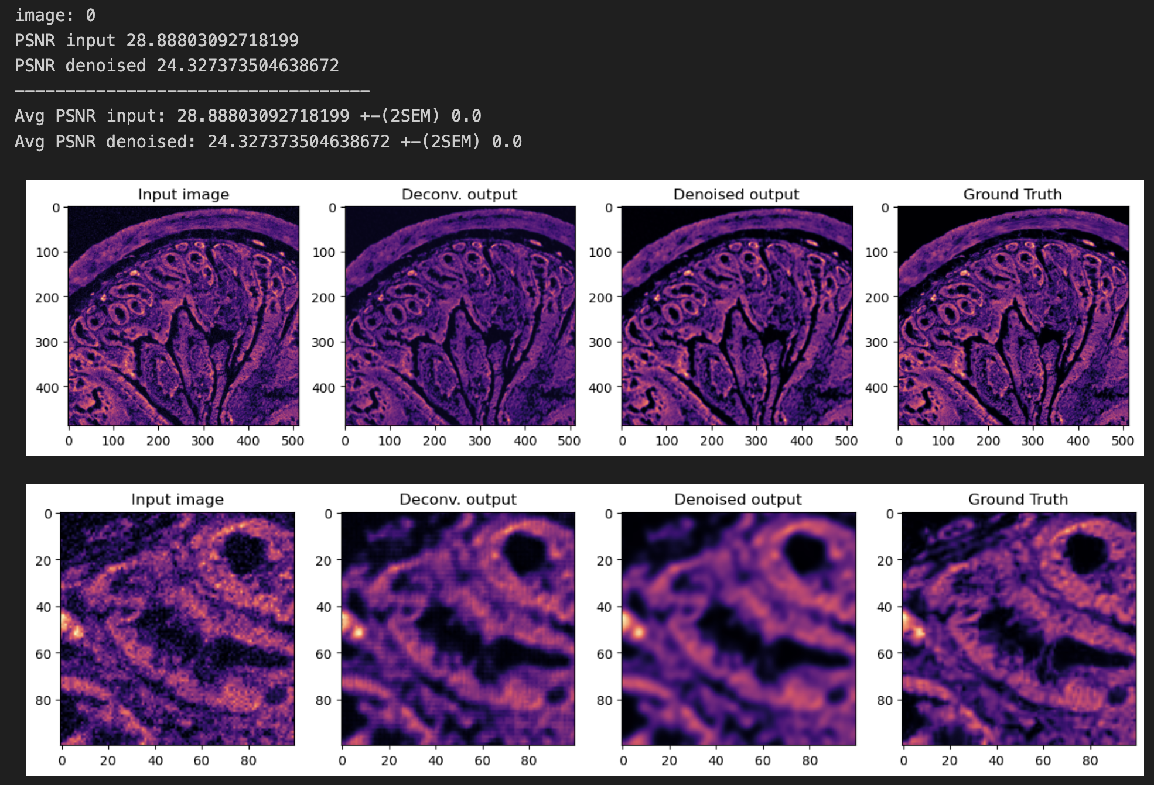
Results of other Fluorescent Noisy Microscopic Image with PSF=1.0

Slide 16

Results of other Fluorescent Noisy Microscopic Image with PSF=1.5

Slide 17
Conclusion
We achieved good results on Gaussian Filter using Non-DL approach which gives us SNR of 29.53
Applied model to the data provided by researchers and achieved SNR of 36.05
Applied the model to our own dataset with different PSF values and achieved PSNR of 31.47 with PSF as 1.0
Applied the model to a fluorescent image with different PSF values and achieved PSNR of 24.32 with all the three PSF values

Slide 18
THANK YOU

